Slide 1
Final Projet
By Lilian BASTARD NAMINZO

Slide 2
What is SQLite ?
11th database engine DB-Engines
Software in C
Relational and transactionnal db engine
Serverless -> local file
Simple to integrate into apps

Slide 3
Portability and performance
All in one file -> easy to attach
No complex setup
Cross-systems (Windows, Mac, Linux...)
Lightweight

Slide 4
Data integrity and portability
ACID :
Atomicity : all-or-nothing operations (commit or abort)
Consistency : data always valid, if rule transgressed -> abort
Isolation : transactions are independant
Durability : changes are permanent + data not stored in volatile memory

Slide 5
Wide application range
Mobile applications (in iOS AND Android)
Cache, app data, settings all without connexion
Desktop apps
Web browsers cookies & preferences
Web projects
Useful to easily save & acces data (SQLite 3 API)
IoT devices
Lightweight => manage data logs and config

Slide 6

What to retain ?
Serverless
Reliable
Lightweight
Very used for local storage

Slide 7
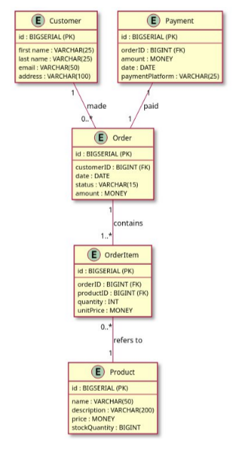
My SQL implementation Diagram

Slide 8
Queries - All orders from a specific customer
Retrieves every order that a customer made, using their email address (could also be with id)
SELECT
c.firstName,
c.lastName,
o.id AS orderID,
o.date AS orderDate,
o.amount AS totalAmount
FROM
customer AS c
JOIN
"order" AS o ON c.id = o.customerID
WHERE
c.email = 'jean.dupont@email.com';

Slide 9
Queries – All items of a specific order
Retrieves all items included in an order using its order id.
SELECT
oi.orderID,
p.name AS productName,
oi.quantity,
oi.unitPrice
FROM
orderitem AS oi
JOIN
product AS p ON oi.productID = p.id
WHERE
oi.orderID = 1;

Slide 10
Queries – All products with low stocks
Retrieves every products with a stock less than 15
SELECT
p.name AS productName,
p.stockQuantity
FROM
product AS p
WHERE
p.stockQuantity < 15
ORDER BY
p.stockQuantity ASC;

Slide 11
Queries – Most trending products
Retrieve the orders that are the most popular to the customers (best sellers)
SELECT
p.id,
p.name,
SUM(oi.quantity) AS totalOrdered
FROM
product AS p
JOIN
orderitem AS oi ON p.id = oi.productID
GROUP BY
p.id, p.name
ORDER BY
totalOrdered DESC

Slide 12
Queries – Average order value
Average price of an order (according to the order made by all the clients)
SELECT
ROUND(AVG(o.amount), 2) AS averageOrderValue
FROM
"order" AS o;

